Slide 1
Hypoxic Respiratory Failure
Notes:
SPEAKER: THIS SLIDE MUST BE SHOWN.

Slide 2
Disclosures
Disclaimer:
This activity has been designed to provide continuing education that is focused on specific objectives. In selecting educational activities, clinicians should pay special attention to the relevance of those objectives and the application to their particular needs. The intent of all Meniscus Educational Institute educational opportunities is to provide learning that will improve patient care. Clinicians are encouraged to reflect on this activity and its applicability to their own patient population.
The opinions expressed in this activity are those of the faculty and reviewers and do not represent an endorsement by Meniscus Educational Institute of any specific therapeutics or approaches to diagnosis or patient management.
Donald M. Null, MD has served as a consultant for Drager and has received honoraria from Ikaria.
Product Disclosure:
This educational activity may contain discussion of published as well as investigational uses of agents that are not approved by the US Food and Drug Administration. For additional information about approved uses, including approved indications, contraindications, and warnings, please refer to the prescribing information for each product.
There is no fee for participating in this activity.

Slide 3
Learning Objectives
Upon completion of this free CE webinar, participants should be able to:
Define hypoxic respiratory failure (HRF) and describe the risk factors, clinical signs, common comorbidities, and differential diagnoses associated with HRF in neonates.
Understand the cardiopulmonary pathophysiology underlying the development of neonatal HRF, in particular the interactions between lung disease, cardiac dysfunction, and pulmonary hypertension.
Appreciate the rationale for treatment approaches that selectively dilate pulmonary vessels.
Understand the clinical trial data that support the use of inhaled nitric oxide (iNO) in neonates with HRF.
Describe the important safety precautions that need to be taken with the use of iNO, including the rationale for avoiding abrupt discontinuation, monitoring of PaO₂, methemoglobin, and inspired NO₂ during therapy, and recognition that use in patients with preexisting left ventricular dysfunction may experience serious side effects.
Establish appropriate treatment protocols for the management of neonatal HRF within their own clinical environments.

Slide 4
Donald M. Null, M.D.
Neonatologist, Newborn Intensive Care Unit
Primary Children’s Medical Center
University of Utah Medical Center and Intermountain Medical Center
Salt Lake City, UT

Slide 5
HRF in the Newborn: A Definition
A relative deficiency of oxygen in arterial blood, often associated with insufficient ventilation¹
This deficiency can be reflected by progressive respiratory and metabolic acidosis and remains a persistent challenge in the management of some newborns
Williams L J, et. al, Neonatal Netw, 2004, 23:5-13
Notes:
HRF is a relative deficiency of oxygen, often associated with insufficient ventilation. This deficiency can be reflected by progressive respiratory and metabolic acidosis and remains a persistent challenge in the management of some newborns.
The overall scope of the problem was described in a large cohort study by Angus et al, who found that the overall incidence of HRF in very low, low, and normal birth weight infants, as measured by the overall rate of mechanical ventilation, was 18 per 1000 live births. This rate was 100-fold greater in very low birth weight infants (700 to 800 g at birth) and was also greater in males and blacks (20 and 29 per 1000, respectively).¹
Overall mortality rates ranged from approximately 10% to 15% at lower and higher level hospitals, respectively. The higher rates observed at higher level hospitals reflect a patient population that typically has more severe illness, as reflected by higher rates of infection, major congenital abnormalities, and hospital mortality.¹
In a separate study, HRF patients were found at follow-up at 5 to 11 years of age to have a higher frequency of learning disabilities, require more remedial help, and have higher rates of sensorineural hearing loss than a matched control group.²
References
1. Angus DC, Linde-Zwirble WT, Clermont G, Griffin MF, Clark RH. Epidemiology of neonatal respiratory failure in the United States: projections from California and New York. Am J Respir Crit Care Med. 2001;164:1154-1160.
Eriksen V, Nielsen LH, Klokker M, Greisen G. Follow-up of 5- to 11-year-old children treated for persistent pulmonary hypertension of the newborn. Acta Paediatr. 2009;98:304-309.
3. Lipkin PH, Davidson D, Spivak L, Straube R, Rhines J, Chang CT; I-NO/PPHN Study Group. Neurodevelopmental and medical outcomes of persistent pulmonary hypertension in term newborns treated with nitric oxide. J Pediatr. 2002;140:306-310.

Slide 6
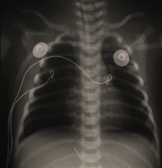
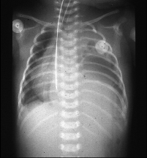
HRF in Newborns:
Some Commonly Occurring Diseases
Idiopathic
PPHN
Respiratory
Distress Syndrome
Meconium Aspiration
Syndrome Syndrome
Congenital
Diaphragmatic Hernia
No underlying
lung disease
Acute lung injury
Surfactant deficiency or inactivation
Pulmonary edema, volume loss
Airway obstruction with gas trapping
Surfactant inactivation
Pneumonitis
Lung hypoplasia
Decreased vascular surface area
Increased pulmonary artery muscularity
Images courtesy of John P. Kinsella, MD, and Steven H. Abman, MD.
Notes:
HRF is a clinical syndrome that occurs in diverse settings that can include a wide spectrum of diseases, including but not limited to these 4 examples.
HRF can occur in infants with meconium aspiration syndrome (MAS), respiratory distress syndrome (RDS), idiopathic persistent pulmonary hypertension of the newborn (PPHN), and congenital diaphragmatic hernia.¹⁻⁴
References
Clark RH; The Near-Term Respiratory Failure Research Group. The epidemiology of respiratory failure in neonates born at an estimated gestational age of 34 weeks or more. J Perinatol. 2005;25:251-257.
Wirbelauer J, Speer CP. The role of surfactant treatment in preterm infants and term newborns with acute respiratory distress syndrome. J Perinatol. 2009;29(suppl 2):S18-S22.
Solarin KO, Zubrow A, Delivoria-Papadopoulos M. Differential diagnosis of neonatal respiratory disorders. In: Spitzer AR, ed. Intensive Care of the Fetus & Neonate, 2nd ed. Philadelphia, PA: Elsevier Mosby; 2005:570-573.
Kinsella JP. Inhaled nitric oxide in the term newborn. Early Hum Dev. 2008:84:709-716.

Slide 7
Pathophysiology of HRF:
The Cardiopulmonary Triad ^{1,2}
Lung disease
  Low and high lung volumes
  Regional gas trapping, hyperinflation
Cardiac disease
  Left ventricular dysfunction
  High right ventricular pressure
Pulmonary vascular disease
  Increased vascular tone and reactivity
  Decreased vascular growth (lung hypoplasia)
  Hypertensive vascular remodeling
Kinsella JP. Early Hum Dev. 2008:84:709-716.
Kinsella JP, Abman SH. J Pediatr. 1995;126:853-864.
Notes:
Whatever the specific disease, HRF can involve the following 3 distinct but overlapping areas of pathophysiology at presentation:
Airway and pulmonary parenchymal abnormalities
Cardiac dysfunction
Pulmonary vascular disorders
While some cases of HRF are attributable to just one area of dysfunction—cardiac, lung, or pulmonary vascular disease—most cases of hypoxemia will involve an interplay of these mechanisms at any given time. Moreover, the contribution of each of these mechanisms may change over time. Therefore, clinicians should continually reassess the underlying pathophysiology and adjust treatment accordingly.
7
References
Kinsella JP. Inhaled nitric oxide in the term newborn. Early Hum Dev. 2008:84:709-716.
Kinsella JP, Abman SH. Recent developments in the pathophysiology and treatment of persistent pulmonary hypertension of the newborn. J Pediatr. 1995;126:853-864.

Slide 8
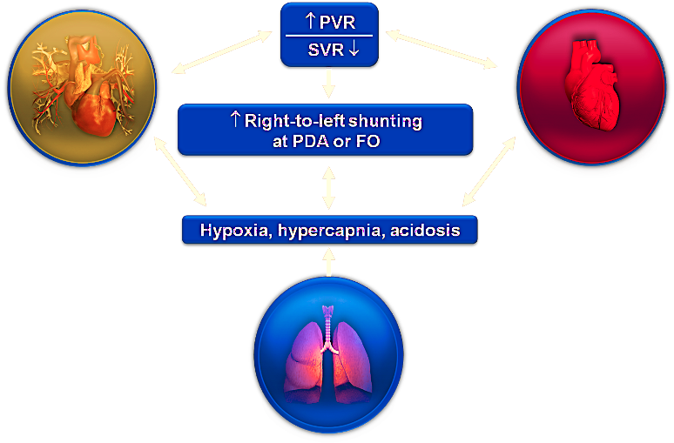
Cardiopulmonary Interactions in Neonatal HRF
PVR
SVR
Right-to-left shunting at PDA or FO
Hypoxia, hypercapnia, acidosis
High vascular tone
Altered reactivity
Structural disease
Hypovolemia
RV pressure overload
LV dysfunction
Lung volume
Compliance
Intrapulmonary shunt
Adapted with permission from Kinsella JP, Abman SH. J Pediatr. 1995;126:853-864.
Notes:
This slide illustrates the complex relationship between the lung, the heart, and the pulmonary vasculature in hypoxic respiratory failure, and how they are interrelated.¹
Disturbances in hypovolemia, cardiac performance, and increased vascular resistance may compromise the balance between pulmonary and systemic circulation.¹
For example, in an infant with lung disease, hypoxia and resultant acidosis may have negative effects on the pulmonary vasculature as well as on the heart. In combination, this can worsen the relationship of pulmonary vascular resistance (PVR) to systemic vascular resistance (SVR), leading to extrapulmonary right-to-left shunting at the patent ductus arteriosus (PDA) or the foramen ovale (FO). Similarly, a poorly functioning heart can lead to acidosis, vasoconstriction, and altered shunting.²
Reference
Kinsella JP, Abman SH. Recent developments in the pathophysiology and treatment
of persistent pulmonary hypertension of the newborn. J Pediatr. 1995;126:853-864.
Abman SH. Personal communication. August 21, 2009.

Slide 9
Cardiopulmonary Interactions
Notes:
SPEAKER: THIS SLIDE MUST BE SHOWN.

Slide 10
HRF in Newborns: Pathophysiology¹
Intrapulmonary shunt: pulmonary arterial blood reaches the pulmonary venous side without passing through ventilated areas of the lung
Extrapulmonary shunt (PPHN): right-to-left shunting of blood bypasses the lung through fetal channels (ductus arteriosus and/or foramen ovale)
Ventilation–perfusion (V/Q) mismatch: imbalance between ventilation and perfusion; alveolar hypoxia, increased dead-space ventilation
Kinsella JP. Early Hum Dev. 2008:84:709-716.
Notes:
Features of HRF may include:
Intrapulmonary shunting, in which arterial blood reaches the pulmonary venous side without passing through ventilated areas of the lung
Extrapulmonary shunting, typically seen in PPHN, in which blood bypasses the lung through so-called fetal channels of the ductus arteriosus and/or the foramen ovale
Ventilation–perfusion (V/Q) mismatch, which can occur in both situations and involves an imbalance between ventilation and perfusion, such as when there is alveolar hypoxia and increased dead-space ventilation
As noted earlier, patients may have more than 1 contributing cause to their HRF.
Reference
Kinsella JP. Inhaled nitric oxide in the term newborn. Early Hum Dev. 2008:84:709-716.

Slide 11
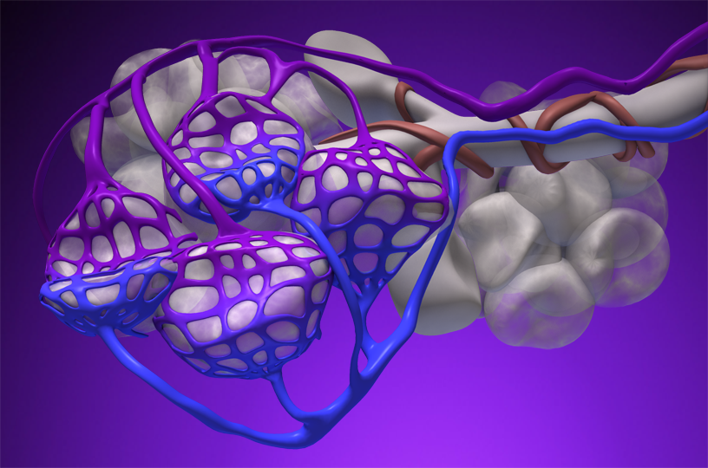
Intrapulmonary Shunt and V/Q Mismatch
PV
PA
PA = pulmonary artery; PV = pulmonary vein.
Notes:
This graphic illustrates an intrapulmonary shunt with V/Q mismatch.
When the alveoli are not fully ventilated, the blood perfusing these underventilated alveoli will be poorly oxygenated when it is returned by pulmonary veins to the left side of the heart.
11
Reference
Kinsella JP. Inhaled nitric oxide in the term newborn. Early Hum Dev. 2008:84:709-716.

Slide 12
HRF in Newborns: Pathophysiology
Kinsella JP. Early Hum Dev. 2008:84:709-716.
Intrapulmonary shunt: pulmonary arterial blood reaches the pulmonary venous side without passing through ventilated areas of the lung
Extrapulmonary shunt (PPHN): right-to-left shunting of blood bypasses the lung through fetal channels (ductus arteriosus and/or foramen ovale)
Ventilation–perfusion (V/Q) mismatch: imbalance between ventilation and perfusion; alveolar hypoxia, increased dead-space ventilation
Notes:
Features of HRF may include:
Intrapulmonary shunting, in which arterial blood reaches the pulmonary venous side without passing through ventilated areas of the lung
Extrapulmonary shunting, typically seen in PPHN, in which blood bypasses the lung through so-called fetal channels of the ductus arteriosus and/or the foramen ovale
Ventilation–perfusion (V/Q) mismatch, which can occur in both situations and involves an imbalance between ventilation and perfusion, such as when there is alveolar hypoxia and increased dead-space ventilation
As noted earlier, patients may have more than 1 contributing cause to their HRF.
Reference
Kinsella JP. Inhaled nitric oxide in the term newborn. Early Hum Dev. 2008:84:709-716.

Slide 13
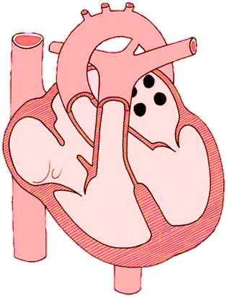
Extrapulmonary Shunting^{1,2}
Ductus
Arteriosus
Foramen
Ovale
Left
Atrium
Right
Atrium
Left
Ventricle
Right
Ventricle
1. Dryden R. Atrial Septal Defect [Image]. Bionalogy 2008 July 3 [cited 2011 Jun 7]; http://www.bionalogy.com/cardiovascular_system.html. 2. Aschner JL, Fike CD. New Developments in the Pathogenesis and Management of Neonatal Pulmonary Hypertension In: Bancalari E, Polin RA eds. The Newborn Lung Neonatology Questions and Controversies Philadelphia, PA Saunders 2008: p 242 Figure 12-1.
Notes:
Extrapulmonary right-to-left shunting is illustrated here.
Right-to-left shunting occurs when blood is shunted from the venous to the arterial circulation without oxygenation. This can occur when high pulmonary vascular resistance results in blood being shunted through the patent ductus arteriosus to the systemic circulation.
Dryden R. Atrial Septal Defect [Image]. Bionalogy 2008 July 3 [cited 2011 Jun 7]; http://www.bionalogy.com/cardiovascular_system.html.
Aschner JL, Fike CD. New Developments in the Pathogenesis and Management of Neonatal Pulmonary Hypertension In: Bancalari E, Polin RA eds. The Newborn Lung Neonatology Questions and Controversies Philadelphia, PA Saunders 2008: p 242 Figure 12-1.

Slide 14
HRF in Newborns: Pathophysiology¹
Kinsella JP. Early Hum Dev. 2008:84:709-716.
Intrapulmonary shunt: pulmonary arterial blood reaches the pulmonary venous side without passing through ventilated areas of the lung
Extrapulmonary shunt (PPHN): right-to-left shunting of blood bypasses the lung through fetal channels (ductus arteriosus and/or foramen ovale)
Ventilation–perfusion (V/Q) mismatch: imbalance between ventilation and perfusion; alveolar hypoxia, increased dead-space ventilation
Notes:
Features of HRF may include:
Intrapulmonary shunting, in which arterial blood reaches the pulmonary venous side without passing through ventilated areas of the lung
Extrapulmonary shunting, typically seen in PPHN, in which blood bypasses the lung through so-called fetal channels of the ductus arteriosus and/or the foramen ovale
Ventilation–perfusion (V/Q) mismatch, which can occur in both situations and involves an imbalance between ventilation and perfusion, such as when there is alveolar hypoxia and increased dead-space ventilation
As noted earlier, patients may have more than 1 contributing cause to their HRF.
Reference
Kinsella JP. Inhaled nitric oxide in the term newborn. Early Hum Dev. 2008:84:709-716.

Slide 15
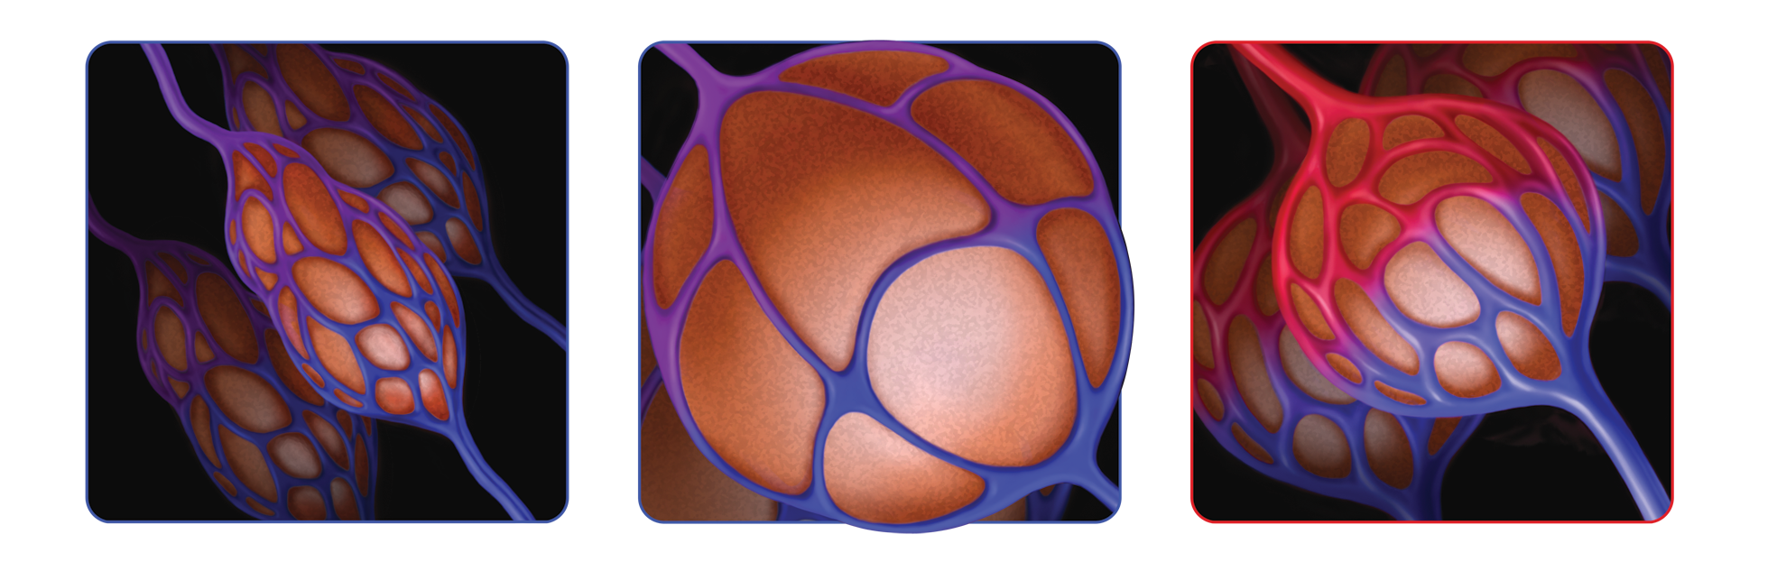
Optimal Oxygenation Requires Matching Ventilation and Perfusion (V/Q)¹
Mismatched
low inflation to perfusion
Mismatched
high inflation with low perfusion
Matched
inflation/perfusion
(V/Q ~ 1)
Poor ventilation despite perfusion produces hypoxemia
Intrapulmonary shunting
Inflation recruits the lung, but with low blood flow
Hypoxemia persists
Adequate ventilation with perfusion optimizes oxygenation
V/Q matching occurs
  Kinsella JP. Early Hum Dev. 2008;84:709-716.
Notes:
15
Hypoxemia can be due to intrapulmonary shunting caused by continued perfusion of unventilated lung areas or by a V/Q mismatch.
On the left, V/Q <1 (low ventilation and normal perfusion)
In the center, V/Q >1 (high ventilation and diminished perfusion—dead space)
On the right, V/Q ~ 1 (adequate ventilation and perfusion)
Oxygen supplementation can often overcome the hypoxemia that occurs when V/Q is decreased, but when the V/Q is high—as occurs in overventilation—PaO₂ will only increase slightly.
References
Kinsella JP. Inhaled nitric oxide in the term newborn. Early Hum Dev. 2008;84:709-716.
Carlo WA, DiFiore JM. Assessment of pulmonary function. In: Martin RJ, Fanaroff AA, Walsh MC, eds. Fanaroff and Martin’s Neonatal-Perinatal Medicine: Disease of the Fetus and Infant. 8th ed. Philadelphia, PA: Mosby Elsevier; 2006:1087-1097.

Slide 16
Disorders that Mimic
Hypoxic Respiratory Failure
Coarctation / Interrupted Arch
Aortic Stenosis / Aortic Insufficiency
Mitral Stenosis / Insufficiency
Notes:
HRF is a relative deficiency of oxygen, often associated with insufficient ventilation. This deficiency can be reflected by progressive respiratory and metabolic acidosis and remains a persistent challenge in the management of some newborns.
The overall scope of the problem was described in a large cohort study by Angus et al, who found that the overall incidence of HRF in very low, low, and normal birth weight infants, as measured by the overall rate of mechanical ventilation, was 18 per 1000 live births. This rate was 100-fold greater in very low birth weight infants (700 to 800 g at birth) and was also greater in males and blacks (20 and 29 per 1000, respectively).¹
Overall mortality rates ranged from approximately 10% to 15% at lower and higher level hospitals, respectively. The higher rates observed at higher level hospitals reflect a patient population that typically has more severe illness, as reflected by higher rates of infection, major congenital abnormalities, and hospital mortality.¹
In a separate study, HRF patients were found at follow-up at 5 to 11 years of age to have a higher frequency of learning disabilities, require more remedial help, and have higher rates of sensorineural hearing loss than a matched control group.²
References
1. Angus DC, Linde-Zwirble WT, Clermont G, Griffin MF, Clark RH. Epidemiology of neonatal respiratory failure in the United States: projections from California and New York. Am J Respir Crit Care Med. 2001;164:1154-1160.
Eriksen V, Nielsen LH, Klokker M, Greisen G. Follow-up of 5- to 11-year-old children treated for persistent pulmonary hypertension of the newborn. Acta Paediatr. 2009;98:304-309.
3. Lipkin PH, Davidson D, Spivak L, Straube R, Rhines J, Chang CT; I-NO/PPHN Study Group. Neurodevelopmental and medical outcomes of persistent pulmonary hypertension in term newborns treated with nitric oxide. J Pediatr. 2002;140:306-310.

Slide 17
Disorders that Mimic
Hypoxic Respiratory Failure
Total Anamalous Venous Return with Obstruction
Pulmonary Vein Stenosis
Pulmonic Stenosis
Left Ventricular Dysfunction
Notes:
HRF is a relative deficiency of oxygen, often associated with insufficient ventilation. This deficiency can be reflected by progressive respiratory and metabolic acidosis and remains a persistent challenge in the management of some newborns.
The overall scope of the problem was described in a large cohort study by Angus et al, who found that the overall incidence of HRF in very low, low, and normal birth weight infants, as measured by the overall rate of mechanical ventilation, was 18 per 1000 live births. This rate was 100-fold greater in very low birth weight infants (700 to 800 g at birth) and was also greater in males and blacks (20 and 29 per 1000, respectively).¹
Overall mortality rates ranged from approximately 10% to 15% at lower and higher level hospitals, respectively. The higher rates observed at higher level hospitals reflect a patient population that typically has more severe illness, as reflected by higher rates of infection, major congenital abnormalities, and hospital mortality.¹
In a separate study, HRF patients were found at follow-up at 5 to 11 years of age to have a higher frequency of learning disabilities, require more remedial help, and have higher rates of sensorineural hearing loss than a matched control group.²
References
1. Angus DC, Linde-Zwirble WT, Clermont G, Griffin MF, Clark RH. Epidemiology of neonatal respiratory failure in the United States: projections from California and New York. Am J Respir Crit Care Med. 2001;164:1154-1160.
Eriksen V, Nielsen LH, Klokker M, Greisen G. Follow-up of 5- to 11-year-old children treated for persistent pulmonary hypertension of the newborn. Acta Paediatr. 2009;98:304-309.
3. Lipkin PH, Davidson D, Spivak L, Straube R, Rhines J, Chang CT; I-NO/PPHN Study Group. Neurodevelopmental and medical outcomes of persistent pulmonary hypertension in term newborns treated with nitric oxide. J Pediatr. 2002;140:306-310.

Slide 18
Management of Patients with Hypoxic Respiratory Failure
Notes:
SPEAKER: THIS SLIDE MUST BE SHOWN.

Slide 19
Pulmonary
Notes:
SPEAKER: THIS SLIDE MUST BE SHOWN.

Slide 20
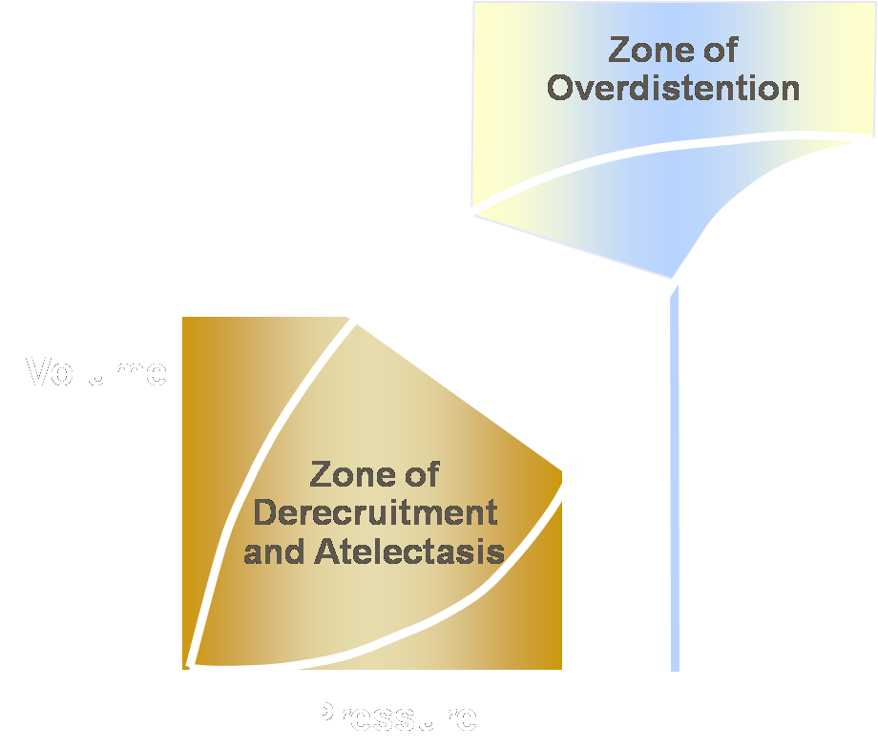
Adequately Recruiting the Lung:
Optimizing Lung Volume Is the First Step
Overdistention and underinflation contribute to high PVR
  High lung volume ventilation
  overdistends, resulting
  in volutrauma
Low lung volume ventilation tears
adhesive surfaces
Figure reprinted from Froese AB. Crit Care Med. 1997;25:906-908. Copyright 2009, with permission from Society of Critical Care Medicine.
Notes:
While optimizing lung volume is the first step in recruiting the lung, care must be taken to achieve atelectasis reversal without causing overdistention. Indeed, extremes of overinflation and underinflation must be avoided, as they alter autonomic tone and increase PVR.
Increases in PVR and pulmonary artery pressure associated with hyperinflation impede right ventricular ejection. Moreover, in what has been called the zone of overdistention, lung injury can occur as a result of edema from fluid accumulation, surfactant degradation, high oxygen exposure, and mechanical disruption.
Reduction in lung volume precipitates hypoxia and stimulates increased vasomotor tone by hypoxic pulmonary vasoconstriction. Additionally, lung injury can result from direct trauma of repeated closure and reexpansion of airways and alveoli, stimulation of the lung’s inflammatory response, inhibition of surfactant, and the effects of local hypoxemia and compensatory overexpansion of the rest of the lung as the lung “shrinks.”

Slide 21
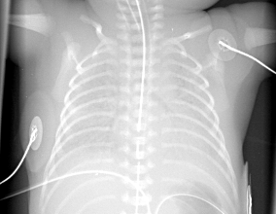
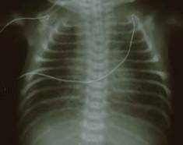
PVR Can Increase at Low or High
Lung Volumes
PVR
Lung Volume
Images courtesy of John P Kinsella, MD, and Steven H. Abman, MD.
Notes:
The bottom line is that PVR can increase at both low and high lung volumes and thus ventilator strategies should seek to avoid these extremes. Both conditions can lead to progressive lung injury that arises not from the disease itself but from well-intentioned interventions.

Slide 22
Cardiac
Improve both right and left heart function
Notes:
HRF is a relative deficiency of oxygen, often associated with insufficient ventilation. This deficiency can be reflected by progressive respiratory and metabolic acidosis and remains a persistent challenge in the management of some newborns.
The overall scope of the problem was described in a large cohort study by Angus et al, who found that the overall incidence of HRF in very low, low, and normal birth weight infants, as measured by the overall rate of mechanical ventilation, was 18 per 1000 live births. This rate was 100-fold greater in very low birth weight infants (700 to 800 g at birth) and was also greater in males and blacks (20 and 29 per 1000, respectively).¹
Overall mortality rates ranged from approximately 10% to 15% at lower and higher level hospitals, respectively. The higher rates observed at higher level hospitals reflect a patient population that typically has more severe illness, as reflected by higher rates of infection, major congenital abnormalities, and hospital mortality.¹
In a separate study, HRF patients were found at follow-up at 5 to 11 years of age to have a higher frequency of learning disabilities, require more remedial help, and have higher rates of sensorineural hearing loss than a matched control group.²
References
1. Angus DC, Linde-Zwirble WT, Clermont G, Griffin MF, Clark RH. Epidemiology of neonatal respiratory failure in the United States: projections from California and New York. Am J Respir Crit Care Med. 2001;164:1154-1160.
Eriksen V, Nielsen LH, Klokker M, Greisen G. Follow-up of 5- to 11-year-old children treated for persistent pulmonary hypertension of the newborn. Acta Paediatr. 2009;98:304-309.
3. Lipkin PH, Davidson D, Spivak L, Straube R, Rhines J, Chang CT; I-NO/PPHN Study Group. Neurodevelopmental and medical outcomes of persistent pulmonary hypertension in term newborns treated with nitric oxide. J Pediatr. 2002;140:306-310.

Slide 23
Medications
^{Oxygen}
^{Steroids}
^{Dopamine}
^{Milrinone}
^{Norepinephrine}
Notes:
HRF is a relative deficiency of oxygen, often associated with insufficient ventilation. This deficiency can be reflected by progressive respiratory and metabolic acidosis and remains a persistent challenge in the management of some newborns.
The overall scope of the problem was described in a large cohort study by Angus et al, who found that the overall incidence of HRF in very low, low, and normal birth weight infants, as measured by the overall rate of mechanical ventilation, was 18 per 1000 live births. This rate was 100-fold greater in very low birth weight infants (700 to 800 g at birth) and was also greater in males and blacks (20 and 29 per 1000, respectively).¹
Overall mortality rates ranged from approximately 10% to 15% at lower and higher level hospitals, respectively. The higher rates observed at higher level hospitals reflect a patient population that typically has more severe illness, as reflected by higher rates of infection, major congenital abnormalities, and hospital mortality.¹
In a separate study, HRF patients were found at follow-up at 5 to 11 years of age to have a higher frequency of learning disabilities, require more remedial help, and have higher rates of sensorineural hearing loss than a matched control group.²
References
1. Angus DC, Linde-Zwirble WT, Clermont G, Griffin MF, Clark RH. Epidemiology of neonatal respiratory failure in the United States: projections from California and New York. Am J Respir Crit Care Med. 2001;164:1154-1160.
Eriksen V, Nielsen LH, Klokker M, Greisen G. Follow-up of 5- to 11-year-old children treated for persistent pulmonary hypertension of the newborn. Acta Paediatr. 2009;98:304-309.
3. Lipkin PH, Davidson D, Spivak L, Straube R, Rhines J, Chang CT; I-NO/PPHN Study Group. Neurodevelopmental and medical outcomes of persistent pulmonary hypertension in term newborns treated with nitric oxide. J Pediatr. 2002;140:306-310.

Slide 24
Adequate Blood Pressure
Notes:
SPEAKER: THIS SLIDE MUST BE SHOWN.

Slide 25
Pulmonary Vascular Bed
Improve V/Q Mismatch
Decrease Pulmonary Vascular Resistance
Notes:
SPEAKER: THIS SLIDE MUST BE SHOWN.

Slide 26
Diagnosis of Persistent Pulmonary Hypertension of Newborn
Notes:
SPEAKER: THIS SLIDE MUST BE SHOWN.

Slide 27


In the CINRGI Study, Clinical Evidence of
PPHN Was Defined as One of the Following:
A
B
Differential oxygenation in preductal and postductal areas
(ie, 5% difference in preductal and postductal saturations by pulse oximetry or arterial blood gases)¹
Marked clinical lability in oxygenation despite optimized treatment of the neonate’s lung disease. Marked clinical lability is defined as more than 2 desaturation (SaO₂ <85%) events occurring within a 12-hour period*¹
Differential oxygenation
>2 desaturation events
in 12 hours
preductal
1
postductal
2
*The attending physician must attribute the desaturation events to persistent pulmonary hypertension of the neonate (PPHN) and not to changes in lung disease or ventilator strategy.
1. Clark RH, et al. N Engl J Med. 2000;342:469-474.
Notes:
References
Clark RH, Kueser TJ, Walker MW, et al; the Clinical Inhaled Nitric Oxide Research Group. Low-dose nitric oxide therapy for persistent pulmonary hypertension of the newborn. N Engl J Med. 2000;342(7):469-474.
Clark, page 469, column 2, paragraph 3, lines 8-12

Slide 28
ECHO Cardiogram
Notes:
SPEAKER: THIS SLIDE MUST BE SHOWN.

Slide 29
Role of Nitric Oxide in
Treatment of Hypoxic Respiratory Failure with PPHN
Notes:
SPEAKER: THIS SLIDE MUST BE SHOWN.

Slide 30
How Does NO Work?
Notes:
SPEAKER: THIS SLIDE MUST BE SHOWN.

Slide 31
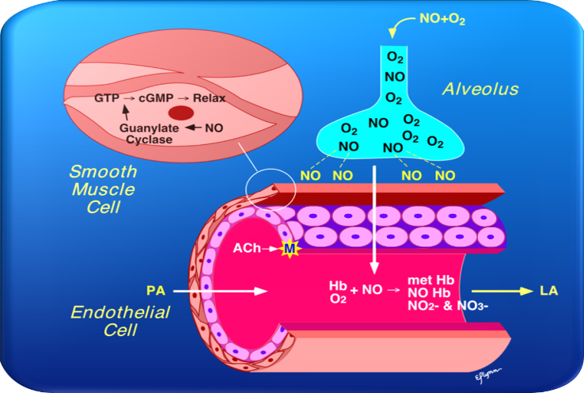
Inhaled Nitric Oxide Causes Selective Pulmonary Vasodilation
Reprinted from Wessel DL, Adatia I. In: Ignarro L, Murad F, eds. Advances in Pharmacology: Nitric Oxide: Biochemistry, Molecular Biology, and Therapeutic Implications. Vol. 34. New York, NY: Academic Press; 1995:425-498. Copyright 1995, with permission from Elsevier.
Notes:
31
31
This slide illustrates how inhaled nitric oxide causes pulmonary vasodilation. Inhaled nitric oxide enters the alveolus with inspired air. Nitric oxide molecules diffuse into the vascular smooth muscle adjacent to pulmonary arterioles where they activate soluble guanylate cyclase (sGC). Because the vasodilatory effects of inhaled nitric oxide are limited to the arterioles adjacent to the alveoli where it has penetrated, it is a selective pulmonary vasodilator without the risk of systemic hypotension.
Note to speaker: Point to the air space between the alveolus and the arteriole when describing the process by which nitric oxide is released from the alveolus and penetrates the smooth muscle cells of the arteriole.
References
Wessel DL, Adatia I. Clinical applications of inhaled nitric oxide in children with pulmonary hypertension. In: Ignarro L, Murad F, eds. Advances in Pharmacology: Nitric Oxide: Biochemistry, Molecular Biology, and Therapeutic Implications. Vol. 34. New York, NY: Academic Press; 1995:425-498.
Abman SH, Griebel JL, Parker DK, Schmidt JM, Swanton D, Kinsella JP. Acute effects of inhaled nitric oxide in children with severe hyoxemic respiratory failure. J Pediatr. 1994;124:881-888.

Slide 32
How Does NO Reduce
V/Q Mismatch?
Notes:
SPEAKER: THIS SLIDE MUST BE SHOWN.

Slide 33
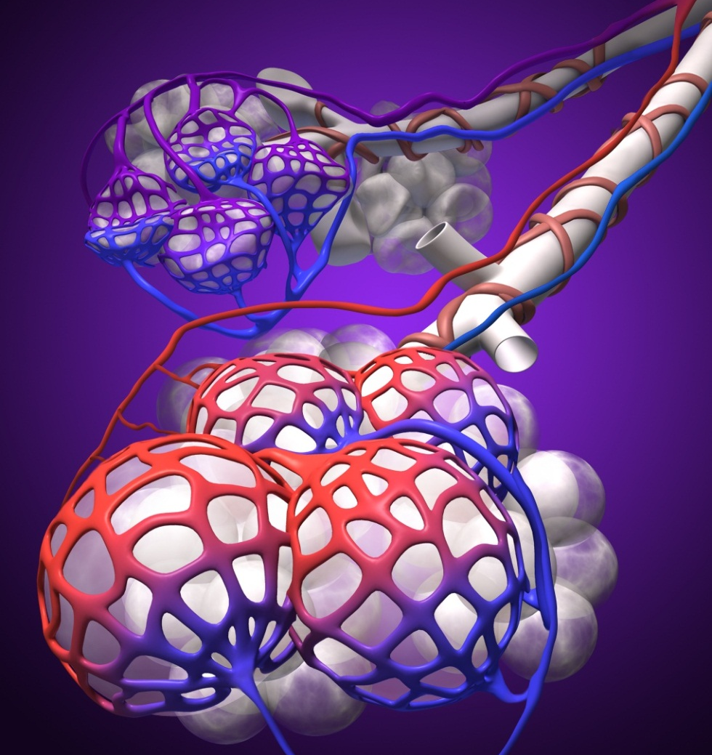
Underinflation Creates V/Q Mismatching¹
Underventilated
portion of lung
  Decreased PaO₂
  Increased pulmonary
  artery pressure and decreased blood flow
PA
PV
PA = pulmonary artery;
PV = pulmonary vein.
1. Rossaint R, et al. N Engl J Med. 1993;328:399-405.
Notes:
Speaker: If this slide is shown, then the next slide must also be shown. Advance slide to change focus to front of slide.
The alveolar sac in back represents a section of the lung that is underinflated and not contributing to oxygenation of the blood.

Slide 34
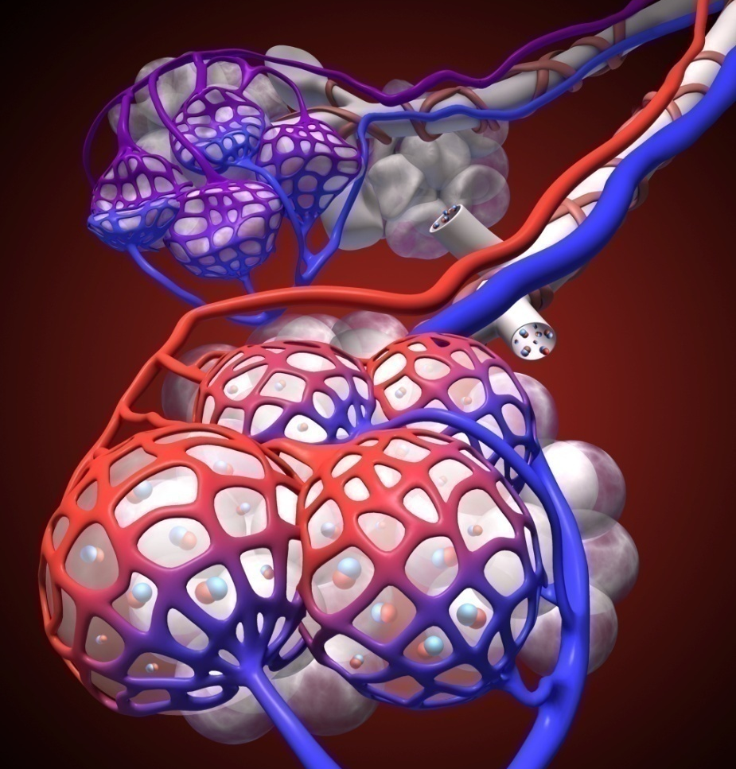
Inhaled Nitric Oxide (iNO) Reduces
V/Q Mismatching¹
Inhaled NO increases vasodilation
  Decreases pulmonary
  artery pressure
  Increases PaO₂
  and blood flow in better ventilated regions
  Improves V/Q
  ratios in neonates
  with HRF
PA
PV
NO
NO
PA = pulmonary artery;
PV = pulmonary vein;
NO = nitric oxide.
1. Rossaint R, et al. N Engl J Med. 1993;328:399-405.
Notes:
As shown in the foreground, INOMAX® penetrates the open alveolar regions and then the walls of the adjacent blood vessels. By selectively dilating these pulmonary arteries and lowering PVR, INOMAX redirects blood flow to the ventilated portions of the lung and increases PaO₂. As it enhances perfusion to better aerated regions of the lung, it also improves V/Q matching.
In treating deficits in the pulmonary vasculature, the use of INOMAX can serve multiple purposes as it exerts selective effects (ie, it lowers PVR thereby decreasing extrapulmonary right-to-left shunting) as well as microselective effects (ie, it improves oxygenation by redirecting blood from poorly aerated or diseased lung regions to better aerated distal air spaces).

Slide 35
Benefits of Inhaled NO
Notes:
SPEAKER: THIS SLIDE MUST BE SHOWN.

Slide 36
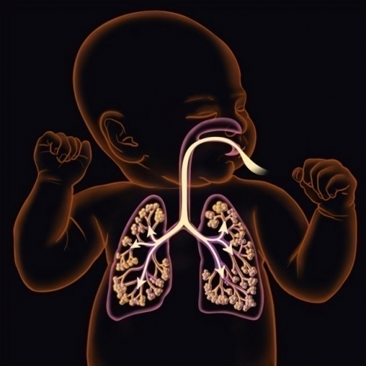
An Inhaled Vasodilator
Inhalation of NO offers selective activity
  The only FDA-approved drug that selectively
  dilates the pulmonary vasculature¹
  Targeted delivery to the pulmonary bed¹
Inhalation of NO offers selective activity
  The only FDA-approved drug that selectively
  dilates the pulmonary vasculature¹
  Targeted delivery to the pulmonary bed¹
Inhalation of NO offers rapid onset
  Clinical responses seen in as little as 30 minutes¹
  Inhaled nitric oxide causes vasodilation in the
  pulmonary vasculature¹
Inhalation of NO offers rapid onset
  Clinical responses seen in as little as 30 minutes¹
  Inhaled nitric oxide causes vasodilation in the
  pulmonary vasculature¹
Inhalation of NO offers rapid clearance
  Rapid inactivation by hemoglobin minimizes systemic effects^{1,2}
  Nitrate, the predominant metabolite of nitric oxide, is rapidly cleared by the kidneys¹
1. INOMAX [package insert]. Hampton, NJ: Ikaria, Inc.; 2013. 2. Steudel W, et al. Anesthesiology. 1999;91:1090-1121.
Notes:
INOMAX [package insert]. Hampton, NJ: Ikaria, Inc.; 2013. 2. Steudel W, et al. Anesthesiology. 1999;91:1090-1121.
References:
INOMAX [package insert]. Hampton, NJ: Ikaria, Inc.; 2013.
Steudel W, Hurford WE, Zapol WM. Inhaled nitric oxide: Basic biology and clinical applications. Anesthesiology. 1999;91(4):1090-1121.

Slide 37
Studies
Notes:
SPEAKER: THIS SLIDE MUST BE SHOWN.

Slide 38
Inhaled Nitric Oxide Phase III Studies for Neonatal HRF
 | CINRGI^{1,2} | NINOS^{2,3} | I-NO/PPHN^{2,4}
Objective | to reduce the need for ECMO | to reduce mortality and/or the need for ECMO | to reduce the incidence of death, ECMO, neurologic injury, or BPD
Design | 186 term/near-term infants (>34 weeks) with HRF and PPHN | 235 term/near-term infants (>34 weeks) with HRF and PPHN | 155 term infants* (≥37 weeks) with HRF and PPHN *Trial halted due to slow enrollment
iNO Dose | 20 ppm, weaned to 5 ppm | 20 ppm, with possible increase to 80 ppm | 5, 20, or 80 ppm
1. Clark RH, et al. N Engl J Med. 2000;342:469-474. 2. INOMAX [package insert]. Hampton, NJ: Ikaria, Inc.; 2013. 3. The Neonatal Inhaled Nitric Oxide Study Group. N Engl J Med. 1997;336:597-604. 4. Davidson D, et al. Pediatrics. 1998;101:325-334.
Notes:
Speaker: Slides 26-30 must be shown together

Slide 39

CINRGI: Efficacy Outcomes^{1,2}
Primary Outcome
Secondary Outcome
N=186
N=168
P<0.001
30-Minute Change From
Baseline (mm Hg)
Events ( %)
-23
P<0.001
*
-59.5
PA-aO₂ (A:a gradient)
Placebo
Inhaled NO
*Primary outcome.
1. INOMAX [package insert]. Hampton, NJ: Ikaria, Inc.; 2013. 2. Data on file. Hampton, NJ: Ikaria; 2009.
Notes:
Speaker: Slides 26-30 must be shown together
There was a significant reduction in ECMO in infants treated with INOMAX®, compared with control infants (31% vs 57%, P<0.001). The incidence of death alone was similar in both groups (3% INOMAX vs 6% placebo).
After the administration of INOMAX, there was a significantly greater decrease in the alveolar/arterial oxygenation gradient compared with infants in the control group (P<0.001).

Slide 40
CINRGI: Retrospective Analysis¹
Inhaled nitric oxide shortens median time on oxygen therapy (17 vs 34 days)
P=0.0264 for log-rank test
17 Days
34 Days
Days
Time on oxygen therapy shown in a Kaplan-Meier analysis of retrospective data from the CINRGI phase III study. Median oxygen time is defined as the day at which 50% of patients went off oxygen therapy. Patients who died or received extracorporeal membrane oxygenation are censored. Total length of hospital stay was not different between study groups. CINRGI was not sufficiently powered to show significance in this endpoint.
1. Data on file. Hampton, NJ: Ikaria, Inc.; 1999.
Notes:
Speaker: Slides 26-30 must be shown together
Data on File A (graph created Young)

Slide 41
NINOS: Efficacy Outcomes^{1,2}
Primary Outcome
Secondary Outcome
P=0.006
N=235
P<0.001
P=0.014
-6.7
Events ( %)
30-Minute Change From
Baseline (mm Hg)
P=0.60
-60
*
PA-aO₂ (A-a gradient)
Placebo
iNO
*Primary outcome.
1. INOMAX [package insert]. Hampton, NJ: Ikaria, Inc.; 2013. 2. The Neonatal Inhaled Nitric Oxide Study Group. N Engl J Med. 1997;336:597-604.
Notes:
Speaker: Slides 26-30 must be shown together
In NINOS, there was a significant reduction in death and/or ECMO in infants treated with INOMAX®, compared with control infants (46% vs 64%, P=0.006). This significance was driven by the reduction of ECMO. The incidence of death alone was lower in the INOMAX patients, but did not achieve statistical significance.¹
After the administration of INOMAX, there was a significantly greater decrease in the alveolar/arterial oxygenation gradient, compared with infants in the control group (P<0.001).²

Slide 42
Safety Outcomes From Phase III Studies
Results from NINOS and CINRGI studies¹
  Combined mortality: placebo (11%); inhaled NO (9%)
  In CINRGI, the only adverse reaction (>2% higher incidence on INOmax than placebo) was hypotension (14% vs. 11%)
  Treatment groups were similar with respect to incidence and severity of intracranial hemorrhage, periventricular leukomalacia, cerebral infarction, seizures requiring anticonvulsant therapy, and pulmonary or gastrointestinal hemorrhage
  6-month follow-up: inhaled NO (n=278); control (n=212)
    No differences in pulmonary disease or neurological sequelae,
    or in the need for rehospitalization or special medical services
1. INOMAX [package insert]. Hampton, NJ: Ikaria, Inc.; 2013.
Notes:
Speaker: Slides 26-30 must be shown together

Slide 43
Golombek et al: Study Design¹
Objectives
  To analyze the effects of inhaled nitric oxide on measures of oxygenation
  To analyze the effects of inhaled nitric oxide across a range of illness severity strata
  To analyze the effects of inhaled nitric oxide on the duration of mechanical ventilation
Methods
  A retrospective pooled analysis of all subjects receiving 20 ppm inhaled nitric oxide in the CINRGI, NINOS, and I-NO/PPHN Phase III trials
  No censoring based on underlying diagnosis or baseline characteristics
1. Golombek SG, et al. Clin Ther. 2010;32:939-948
Notes:
Speaker: Slides 41-45 must be shown together.
Since the published literature does not provide conclusive evidence of a relationship between severity of illness and response to INOMAX® therapy, a retrospective pooled analysis of the 3 largest INOMAX clinical trials was undertaken.
The objectives of this analysis were:
To analyze the effects of INOMAX on measures of oxygenation
To analyze the effects of INOMAX across a range of illness severity strata
To analyze the effects of INOMAX on the duration of mechanical ventilation
For the purposes of this analysis, only those subjects who received 20 ppm INOMAX, regardless of the underlying diagnosis, were compared with similar placebo-treated patients.

Slide 44
Golombek et al: Oxygenation Results¹
Inhaled nitric oxide causes rapid improvement (at 30 min) in oxygenation
P<0.001
P=0.046
P<0.001
P<0.001
Change in mean PaO₂ at
30 Minutes (mm Hg [kPa])
Ventilation
Ventilation
+ iNO
Baseline
(N=227)
(N=75)
(N=186)
(N=493)
1. Golombek SG, et al. Clin Ther. 2010;32:939-948.
Notes:
Speaker: Slides 41-45 must be shown together.
By improving perfusion, INOMAX® delivers a rapid increase in oxygenation. The blue bars represent ventilation alone, while the red bars represent ventilation plus INOMAX. In each of these 3 NDA-submitted studies, INOMAX significantly improved PaO₂ within 30 minutes versus ventilation alone.

Slide 45
Golombek et al: Oxygenation Results¹
Inhaled NO improves oxygenation in severe and very severe HRF
Severe
Very Severe
P<0.001
P<0.001
Ventilation
Change in mean PaO₂ at 30 Minutes
by Baseline OI (mm Hg [kPa])
Ventilation
+ iNO
Baseline OI =
(n=170)
(n=186)
1. Golombek SG, et al. Clin Ther. 2010;32:939-948.
Notes:
Speaker: Slides 41-45 must be shown together.
Advance the slide to complete the build.
By pooling the data from the 3 Phase III trials the authors were able to look at oxygenation results across disease severities (measured by OI). In support of results in the literature, this pooled analysis showed that the addition of INOMAX® produced a significant improvement in PaO₂ at 30 minutes for the very severe population (OI >40) as well as for the severe population (>25 to ≤40), versus ventilation alone (P<0.001).

Slide 46
Golombek et al: Oxygenation Results¹
Inhaled NO improves oxygenation even in mild and moderate HRF
Mild
Moderate
Severe
Very Severe
P=0.003
P=0.004
P<0.001
P<0.001
Ventilation
Change in mean PaO₂ at 30 Minutes
by Baseline OI (mm Hg [kPa])
Ventilation
+ iNO
Baseline OI =
(n=40)
(n=91)
(n=170)
(n=186)
1. Golombek SG, et al. Clin Ther. 2010;32:939-948.
Notes:
Speaker: Slides 41-45 must be shown together.
However, it was interesting to see that there was a similar benefit when the analysis also included infants with mild to moderate HRF (OI ≤25). These data indicate that INOMAX® improves oxygenation across all levels of severity (including mild and moderate) versus ventilation alone.
It has been known for a long time that INOMAX improves oxygenation in neonates with severe HRF, but this retrospective analysis indicates that it also improves oxygenation in neonates with mild and moderate HRF.

Slide 47
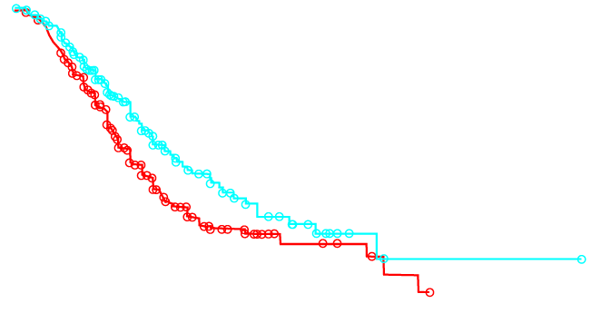
Golombek et al: Time on Vent Results¹
Inhaled NO reduces median days on mechanical ventilation (11 vs. 14 days)
1.00
Placebo
iNO 20 ppm
0.75
Proportion of Patients
Requiring Mechanical Ventilation
0.50
P=0.003
0.25
0.00
0
10
20
30
40
50
Days on Mechanical Ventilation
This is a Kaplan-Meier analysis of pooled data from 3 independent controlled studies, NINOS, CINRGI, and I-NO/PPHN (N=243). Outliers are removed for visual purposes.
1. Golombek SG, et al. Clin Ther. 2010;32:939-948.
Notes:
Speaker: Slides 41-45 must be shown together.
This is a Kaplan-Meier analysis (ie, the probability of being ventilated over time) of pooled data from NINOS, CINRGI, and I-NO/PPHN. Adding INOMAX® shortened the median time on ventilation. Within this pooled data, at the point that 50% of patients were off therapy, the INOMAX patients had a savings of 3 ventilator days (11 vs 14 days) (P=0.003).
NOTE: Patients who died or went to extracorporeal membrane oxygenation were excluded from the analysis as their inclusion would have falsely skewed the data in favor of placebo.

Slide 48
González et al: Study Design¹
Prospective, randomized, controlled, open-label,
two-center trial
Patients: 56 term/near-term infants (≥35 weeks gestation) with HRF and PPHN
  OI between 10 and 30 (mild to moderate severity)
Dosing: 20 ppm, weaned to 5 ppm
Objective: to evaluate whether early treatment
with iNO can prevent infants with moderate respiratory failure from developing severe HRF (OI ≥40)
1. González A, et al. J Perinatol. 2010;30:420-424.
Notes:
Speaker: Slides 46-50 must be shown together .
A recently published study provides further support for early treatment with iNO. This prospective, randomized, controlled, open-label, multicenter trial was undertaken to evaluate whether early treatment with iNO can prevent disease progression. Since ECMO was not available at their institutions, the authors wanted to try to prevent HRF from becoming more severe.
In 2 study centers in Chile, 56 infants ≥35 weeks gestation with an OI between 10 and 30 (mild to moderate severity) were enrolled. iNO was initially dosed at 20 ppm, but was weaned to 5 ppm as allowed.
The trial was not industry sponsored
To conserve resources, the trial was performed with an open label design
Unlike the US, ECMO was not available in Chile during the study period. Therefore, the results of the study should be interpreted with caution

Slide 49
González et al:
Treatment Failure Outcomes¹
Early iNO significantly decreased the probability of developing severe disease as shown by the primary endpoint, treatment failure
61%
(17/28)
Placebo
Percent of Patients Experiencing
Treatment Failure
25%
(7/28)
iNO
P<0.05
n=28
n=28
Treatment Failure (OI >40 within 48 hours)
1. González A, et al. J Perinatol. 2010;30:420-424.
Notes:
Speaker: Slides 46-50 must be shown together .
The primary endpoint was treatment failure, defined as a worsening in respiratory status during the first 48 hours based on an increase in the OI to >40.
17 of the 28 (61%) control infants vs 7 of the 28 (25%) infants receiving early iNO treatment developed an OI >40 within 48 hours (P<0.05).
Control infants who failed were transitioned to iNO. 6 of these 17 control infants were successfully treated with iNO.
Those who did not respond to iNO in either group were transitioned to iNO plus HFOV.

Slide 50
González et al: OI Outcomes
Early iNO significantly reduced OI over time in infants
with mild to moderate HRF
17 of the 28 control infants reached an
OI >40 and were switched to iNO
Adapted with permission from González A, et al. J Perinatol. 2010;30:420-424.
Notes:
Speaker: Slides 46-50 must be shown together .
Infants receiving early iNO treatment had a significant increase in PaO₂ from baseline (data not provided in paper). This led to a significant decrease in OI. OI decreased from 22.2 at baseline to 19.0 at 4 hours (P<0.05) and continued decreasing over time. OI in the control infants remained significantly higher over the 48 hour study period (P<0.01).
As this study was done in infants with mild to moderate HRF, the results independently support the retrospective analysis of the INOMAX Phase III trials by Golombek et al.

Slide 51
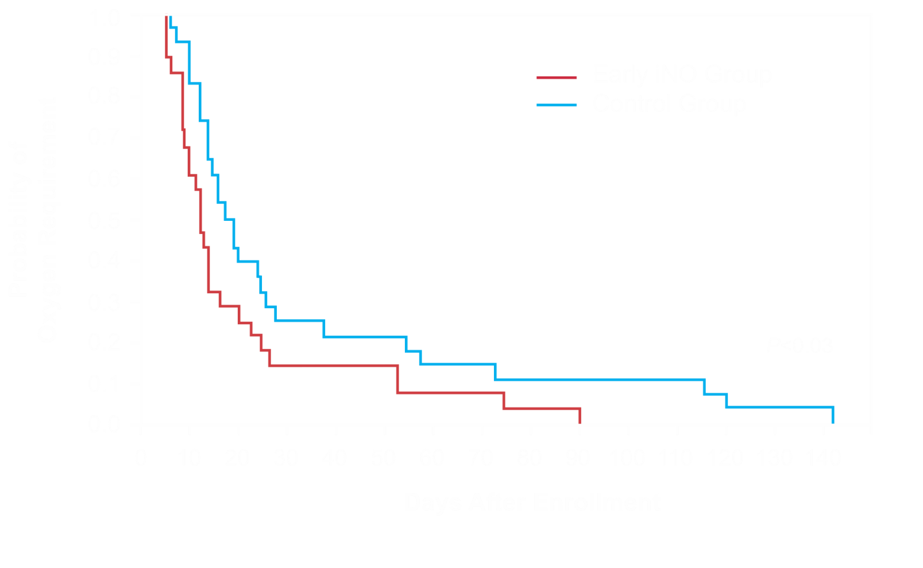
González et al: Days on Oxygen Therapy
Early iNO significantly reduced the median time on oxygen therapy
(11.5 days vs 18 days, P<0.03)
Survival
plot of the probability of oxygen therapy requirement after enrollment in the trial.
Adapted with permission from González A, et al. J Perinatol. 2010;30:420-424.
Notes:
Speaker: Slides 46-50 must be shown together .
Gonzalez, page 422, Table 3 & page 423, Figure 2

Slide 52
González et al: Safety¹
Patients treated with iNO did not have elevated blood levels of methemoglobin or high levels of NO₂ in the ventilatory circuit
There were no differences between groups in the incidence of other neonatal complications such as bleeding and/or coagulation disorders, hypotension,
or infections
1. González A, et al. J Perinatol. 2010;30:420-424.
Notes:
Speaker: Slides 46-50 must be shown together .

Slide 53
Nitric Oxide Dosage and Administration
Notes:
SPEAKER: THIS SLIDE MUST BE SHOWN.

Slide 54
Inhaled Nitric Oxide Dosage and Administration
Recommended starting dose = 20 ppm¹
  Risk of methemoglobinemia and elevated NO₂ levels increases significantly at doses >20 ppm
  Clinical trials dosing (CINRGI)
    If oxygenation improved at 20 ppm, dose reduced to 5 ppm as tolerated at end of 4 hours of treatment
  Clinical trial dosing (NINOS)
    Dose increase to 80 ppm permitted if no improvement at 20 ppm; however, no significant improvement was seen at 80 ppm
1. INOMAX [package insert]. Hampton, NJ: Ikaria, Inc.; 2013.
Notes:
INOMAX® should be administered according to the manufacturer’s instructions.¹
1. INOMAX [package insert]. Hampton, NJ: Ikaria, Inc.; 2013.

Slide 55
Inhaled Nitric Oxide Dosage and Administration (con’t)
Infants who cannot be weaned from inhaled nitric oxide by 4 days should undergo careful diagnostic workup for other diseases
When FiO₂ is <0.60 and PaO₂ is >60, support can be safely weaned if there is no increase in FiO₂ of >15%¹
1. Kinsella JP, Abman SH. J Pediatr. 2000;136:717-726.
Notes:
Infants who cannot be weaned from INOMAX by 4 days should undergo careful diagnostic workup for other diseases.¹ When FiO₂ is <60% and PaO₂ is >60, support can be safely weaned, if there is no increase in FiO₂ of >15%.²
First bullet point adapted from the European SPC
Kinsella JP, Abman SH. J Pediatr. 2000;136:717-726.

Slide 56
Safety Issues
Notes:
SPEAKER: THIS SLIDE MUST BE SHOWN.

Slide 57
Important Safety Information When Using Inhaled Nitric Oxide¹
Rebound
  Abrupt discontinuation of INOmax may lead to increasing pulmonary artery pressure and worsening oxygenation even in neonates with no apparent response to nitric oxide for inhalation.
Methemoglobinemia and NO₂ levels
  Increases with dose of iNO
  Nitric oxide donor compounds may have an additive effect with INOmax on the risk of developing methemoglobinemia
  Nitrogen dioxide may cause airway inflammation and damage to lung tissues
  Monitor for PaO₂, methemoglobin, and inspired NO₂ during INOmax administration.
Pre-existing left ventricular dysfunction
  Inhaled NO may increase pulmonary capillary wedge pressure leading to pulmonary edema
Use only with an INOmax DS_{IR}®, INOmax® DS, or INOvent® operated by trained personnel
1. INOMAX [package insert]. Hampton, NJ: Ikaria, Inc.; 2013.
Notes:
Speaker: This slide must be shown.
INOMAX® should be used in accordance with prescribing information. Abrupt discontinuation of INOMAX can lead to a rebound effect and worsening oxygenation. Therefore, a weaning and discontinuation plan should be used to withdraw INOMAX therapy.
Methemoglobinemia and elevated NO₂ levels both increase with INOMAX dosage and increase in FiO₂. At the recommended 20-ppm dose, neither reaches significant levels.
Use caution in patients with pre-existing left ventricular dysfunction to avoid pulmonary edema.

Slide 58
Methemoglobin Levels
Notes:
SPEAKER: THIS SLIDE MUST BE SHOWN.

Slide 59
Methemoglobin Levels¹
6
5
4
Methemoglobin Levels, %
3
2
1
0
2
4
6
8
10
12
Hours
Inhaled nitric oxide (ppm):
80
20
5.0
Control
1. INOMAX [package insert]. Hampton, NJ: Ikaria, Inc.; 2013.
Notes:
During the INOT 01/02 trial, methemoglobin levels at baseline and during the administration of NO were determined for up to 2 days in term infants with PPHN.
Methemoglobinemia (>7%) occurred in 13 patients, all of whom had received nitric oxide at 80 ppm; there was no indication of methemoglobinemia in patients administered nitric oxide at 20 ppm or 5 ppm. When this methemoglobin level was reached, treatment was either discontinued or reduced by 20% until methemoglobin levels were below 7%.
In the CINRGI trial, 2 patients (2%) were withdrawn from inhaled nitric oxide because of methemoglobin levels >4% at doses of 20 ppm.

Slide 60
Case Scenario
Respiratory Distress Syndrome (RDS)
Notes:
SPEAKER: THIS SLIDE MUST BE SHOWN.

Slide 61
Case Study
Term male infant 3.7 kg
SVD
Apgars 7 & 8
Mother GBS positive
  - Respiratory distress within 10 minutes of
  birth
  - Oxygen sat 75 in room air 88% in 100% O2

Slide 62
¯
Intubated and started on PSVG
Tidal volume 6 cc/kg
PEEP – 6, Paw – 13, Rate – 40, 100% FiO2
ABG - pH 7.2, pCO2 – 65, pO – 40
Preductal sat 90 Postductal sat 80
Cardiac ECHO – consistent with systemic PVR
Right and left ventricular function okay

Slide 63
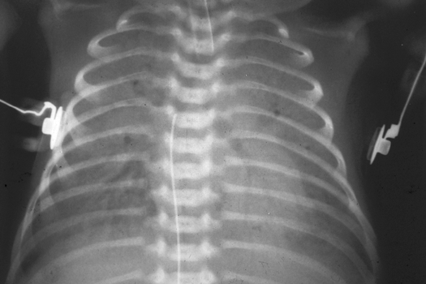

Slide 64
Ventilator choices
A. Continue PSVG and increase tidal volume
B. Add Nitric Oxide
C. Begin HFOV

Slide 65
Infant started on Nitric Oxide 20 PPM
Tidal volume increased to 7 cc/kg
PEEP increased to 8
Mean airway pressure increased to 15
Blood gas O2 at 100%, pH - 7.24, pCO2 - 62
pO2 - 44, preductal sat at 90
Postductal sat at 82

Slide 67
Choices
Increase Nitric Oxide to 30 PPM
Increase tidal volume to 8 cc/kg
Begin HFOV

Slide 68
Why is Nitric Oxide not working?

Slide 69
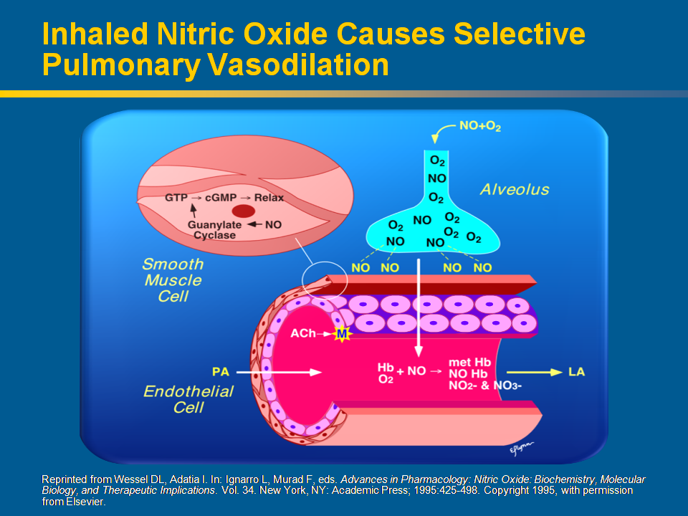
Notes:
69
69
This slide illustrates how inhaled nitric oxide causes pulmonary vasodilation. Inhaled nitric oxide enters the alveolus with inspired air. Nitric oxide molecules diffuse into the vascular smooth muscle adjacent to pulmonary arterioles where they activate soluble guanylate cyclase (sGC). Because the vasodilatory effects of inhaled nitric oxide are limited to the arterioles adjacent to the alveoli where it has penetrated, it is a selective pulmonary vasodilator without the risk of systemic hypotension.
[Note to speaker: Point to the air space between the alveolus and the arteriole when describing the process by which nitric oxide is released from the alveolus and penetrates the smooth muscle cells of the arteriole.]
References
Wessel DL, Adatia I. Clinical applications of inhaled nitric oxide in children with pulmonary hypertension. In: Ignarro L, Murad F, eds. Advances in Pharmacology: Nitric Oxide: Biochemistry, Molecular Biology, and Therapeutic Implications. Vol. 34. New York, NY: Academic Press; 1995:425-498.
Abman SH, Griebel JL, Parker DK, Schmidt JM, Swanton D, Kinsella JP. Acute effects of inhaled nitric oxide in children with severe hyoxemic respiratory failure. J Pediatr. 1994;124;881-888.

Slide 70
Patient started on HFOV*
Paw at 19, Frequency at 8 Hz, Amp at 35
ABG pH - 7.30, pCO2 - 54, pO2 - 56, oxygen at 100%
Preductal sat at 93, postductal sat at 88
* Kinsella, J.P., et. al. Ramdomized, multicenter trial of inhaled nitric oxide and high-frequency oscillatory ventilation in severe, persistent pulmonary hypertension of the newborn. J Pediatr 1997 131:55-62

Slide 71
Choices
A. Increase mean airway pressure
B. Increase amplitude
C. Decrease frequency

Slide 72
Mean airway pressure increased to 24
Blood gas oxygen at 100%, pH - 7.38
pCO2 - 48, pO2 - 180
Preductal sat at 99, postductal sat at 98

Slide 73
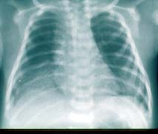

Slide 74
6 hours later
Patient’s blood pressure decreases from 68/40, 52 to 48/30, 38
O2 sat decreases from 98 pre and post ductal to 92 preductal and 89 postductal
Ventilator settings unchanged, mean airway pressure at 24
Frequency at 8 Hz, Amp at 35, oxygen at 80% which is up from 55%
ABG pH - 7.28, pCO2 - 58, pO2 - 58

Slide 75
What should be considered?
Pneumothorax
Cardiac failure
Lung over inflation or underinflation

Slide 76
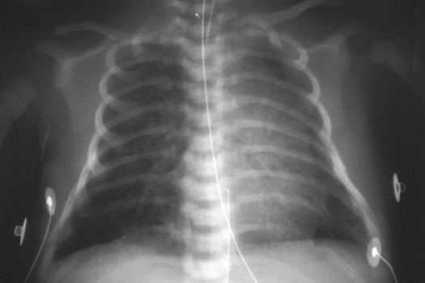

Slide 77
Mean airway reduced to 21
Oxygen reduced to 50%
Over next 6 hours mean airway pressure reduced to 17 and oxygen decreased to 35%

Slide 78
Key Takeaways
HRF continues to be a therapeutic challenge
Successful treatment of HRF requires an understanding of the underlying interactions between lung disease, cardiac dysfunction, and pulmonary hypertension
Inhales nitric oxide, combined with adequate ventilation, can improve oxygenation in neonates with HRF at all levels of disease severity
Earlier use of inhaled nitric oxide in neonates with respiratory failure may improve oxygenation¹ and decrease the probability of developing severe HRF²
Inhales nitric oxide is well tolerated. Adverse reactions, rebound pulmonary hypertension, methemoglobinemia, and increased NO₂ are manageable and dose related³
1. Golombek SG, et al. Clin Ther. 2010;32:939-948. 2. González A, et al. J Perinatol. 2010;30:420-424. 3. INOMAX [package insert]. Hampton, NJ: Ikaria, Inc.; 2013.

